Slide 1
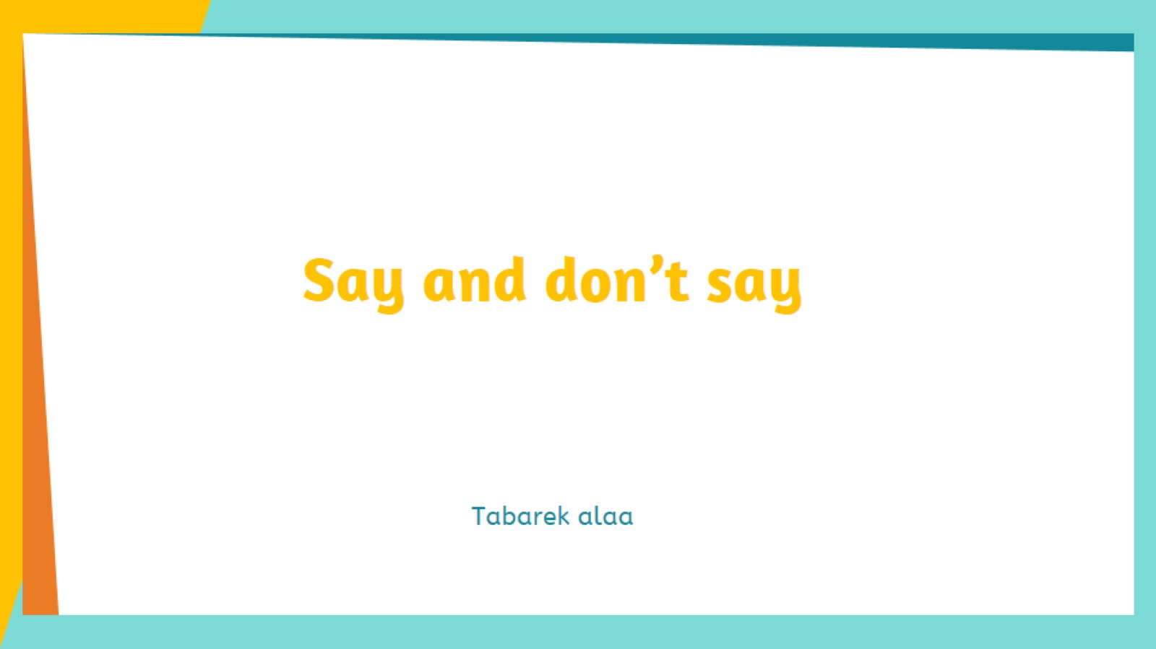
Say and don’t say

Slide 2
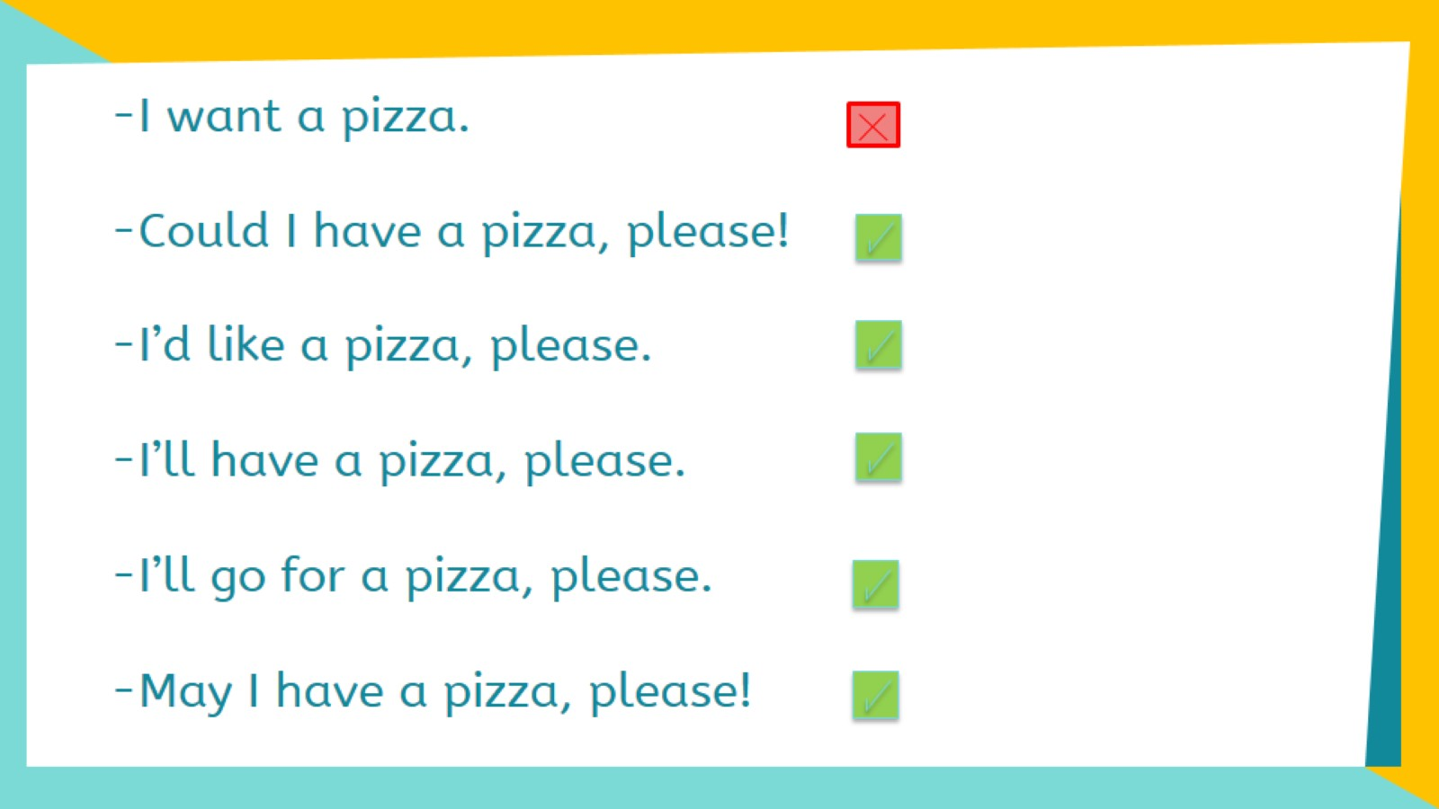

Slide 3
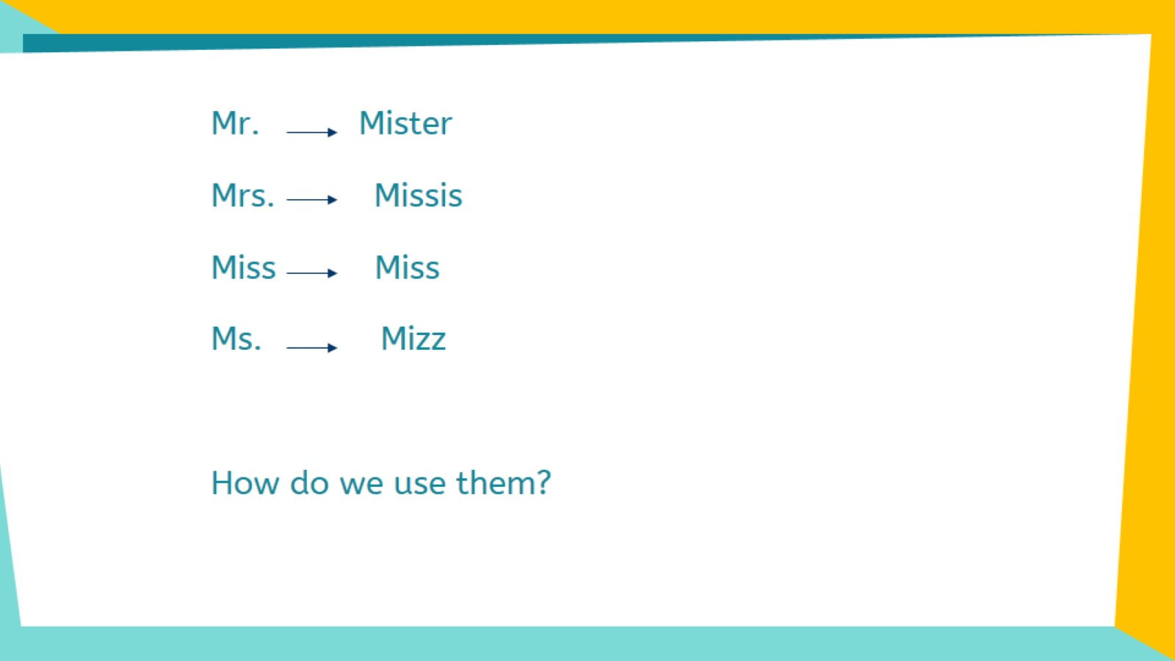

Slide 4
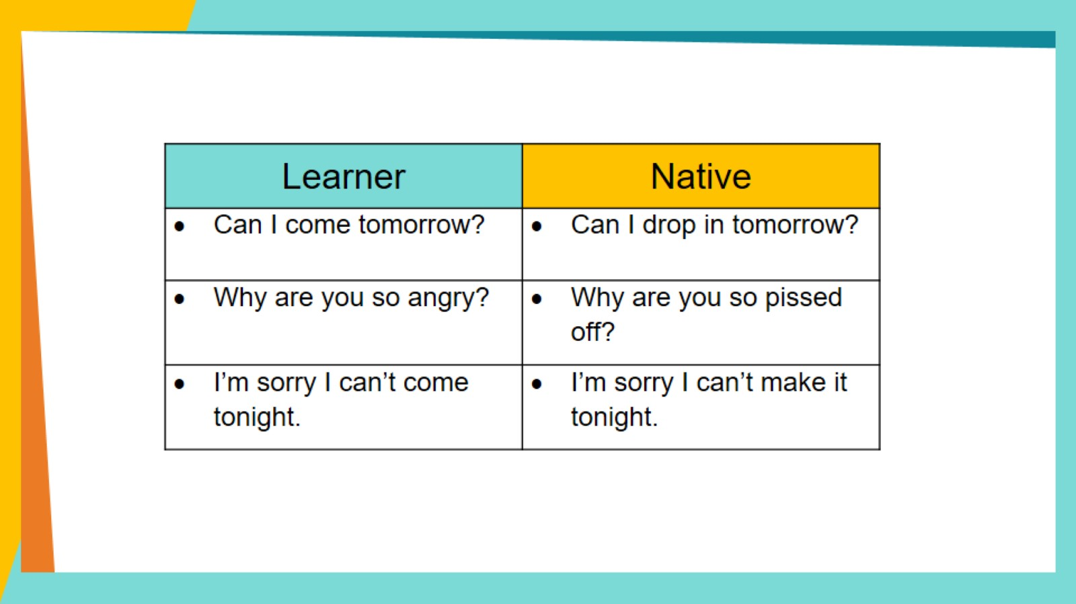

Slide 5
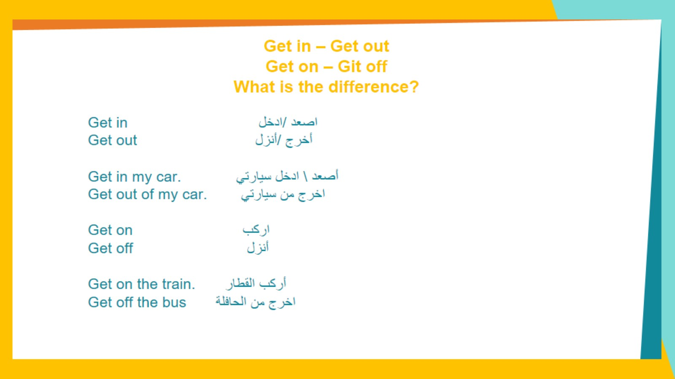
Get in – Get out Get on – Git off What is the difference?

Slide 6
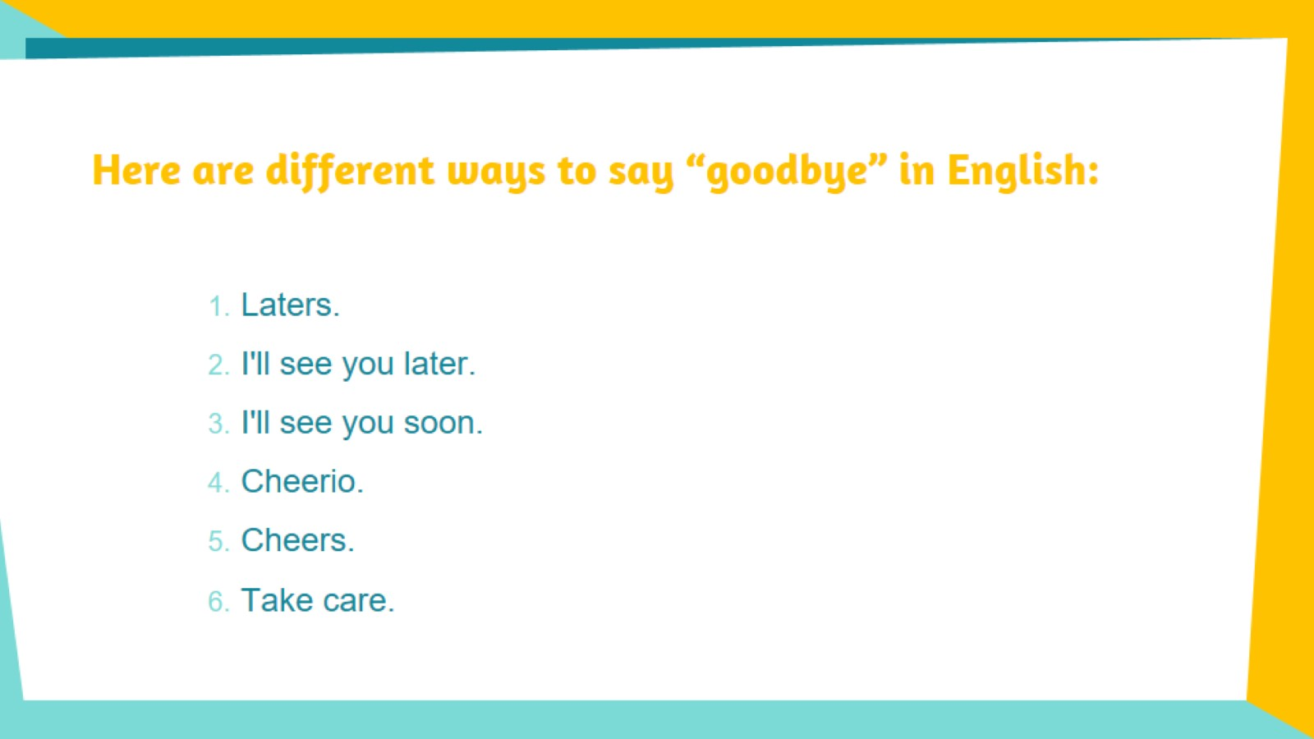
Here are different ways to say “goodbye” in English:

Slide 7
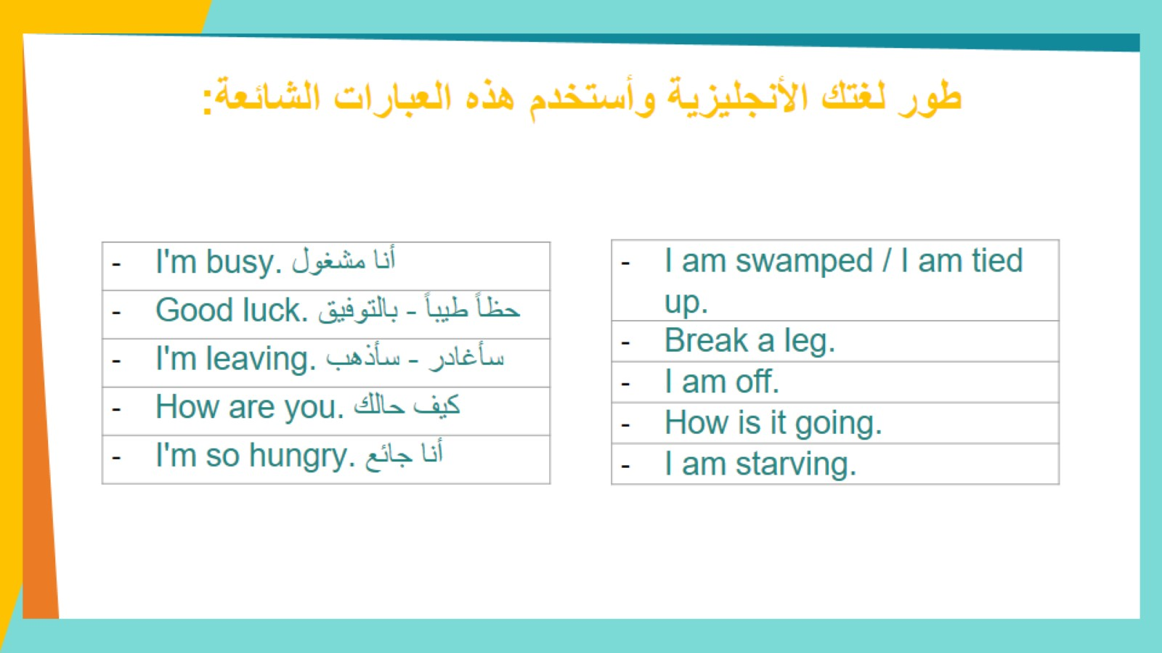
طور لغتك الأنجليزية وأستخدم هذه العبارات الشائعة:

Slide 8
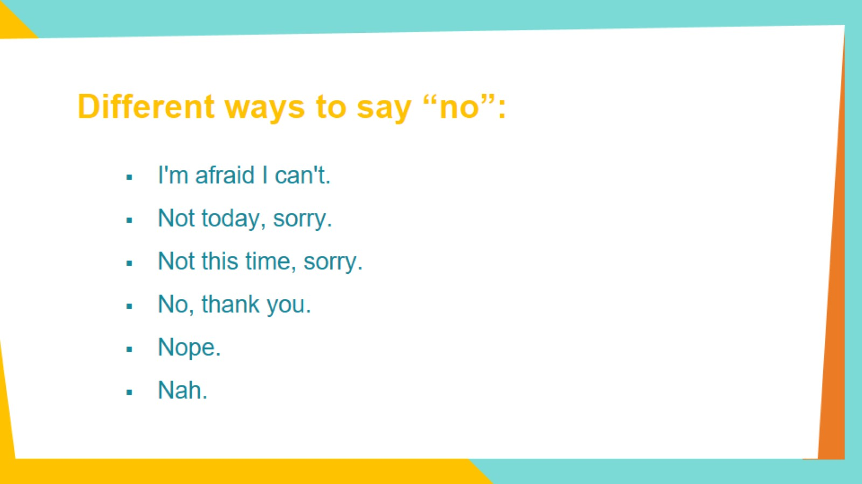
Different ways to say “no”:

Slide 9


